Slide 1
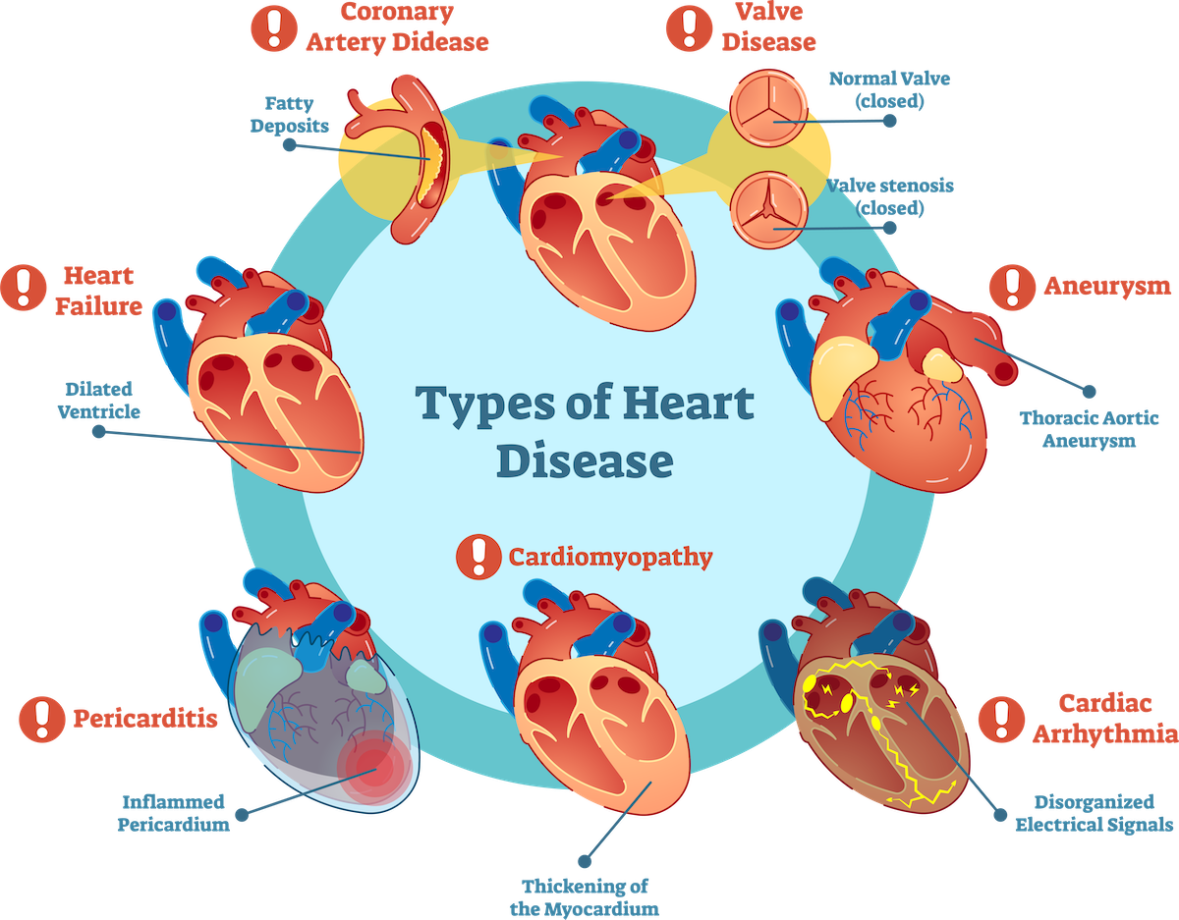

Optimizing Heart Disease Prediction
Unveiling Insights for Healthier Hearts through Data Science
Presented By: Group 3

Slide 2

Problems With Inaccurate Predictions
Inaccurate heart disease prediction leads to preventable fatalities and increased healthcare burdens.
Heart disease is a leading cause of mortality; early and accurate prediction can save lives and reduce treatment costs.
Early detection is key to effective treatment.
Enhancing predictive precision offers a pathway to alleviate strain on healthcare systems.

Slide 3



Project Goals and Business Impacts
Our project aims to improve heart disease prediction by harnessing advanced machine learning techniques, ultimately saving lives and reducing healthcare costs.
The primary goal is to develop an accurate predictive model that can identify heart disease risks earlier and more reliably, thereby assisting healthcare providers in making informed decisions and optimizing patient care.
Successful implementation of this project will set new benchmarks in predictive healthcare, leading to more preventative care approaches, optimized healthcare resource management, and improved patient health outcomes.

Slide 4
Understanding the Data: Cardiovascular Disease Study
Data Source: Dataset acquired from Kaggle, a platform for predictive modeling and analytics competitions. All the values were collected during medical examination.
Dataset Overview: Cardiovascular Disease dataset includes clinical and physical parameters of patients.
Inputs Variables: Age, blood pressure, cholesterol levels, glucose levels, heart rate, and more.
Output Variable: Presence or absence of cardiovascular disease.
Purpose of Analysis: To predict the likelihood of a patient having cardiovascular disease using machine learning models.

Slide 5
Unveiling Data Dimensions: A Closer Look at the Cardiovascular Disease Dataset
Title | Input Feature | Data Type
Age | Objective Feature | int (days)
Height | Objective Feature | int (cm)
Weight | Objective Feature | float (kg)
Gender | Objective Feature | categorical code
Systolic blood pressure | Examination Feature | int
Diastolic blood pressure | Examination Feature | int
Cholesterol | Examination Feature | 1: normal, 2: above normal, 3: well above normal
Glucose | Examination Feature | 1: normal, 2: above normal, 3: well above normal
Smoking | Subjective Feature | binary
Alcohol intake | Subjective Feature | binary
Physical activity | Subjective Feature | binary
Presence or absence of cardiovascular disease | Target Variable | binary
Dataset Structure:
It comprises of 70000 rows and 13 columns, representing individual patient records and medical attributes.
Input Features:
Objective: Factual Information;
Examination: Results of Medical Examinations;
Subjective: Information given by the Patient.

Slide 6
Data Statistics Overview 1
Data | Missing Values | Mean | Median | Mode | Variance
Id | 0.005714 | 49970.694540 | 50000.5 | 0.0 | 8.323696e+08
Age | 0.002857 | 19468.881539 | 19703.0 | 18236.0 | 6.087476e+06
Gender | 0.002857 | 1.349581 | 1.0 | 1.0 | 2.273775e-01
Height | 0.002857 | 164.359439 | 165.0 | 165.0 | 6.740630e+01
Weight | 0.000000 | 74.205690 | 72.0 | 65.0 | 2.072378e+02
Systolic blood pressure | 0.005714 | 128.817504 | 120.0 | 120.0 | 2.372087e+04
Diastolic blood pressure | 0.000000 | 96.630414 | 80.0 | 80.0 | 3.552189e+04
Cholesterol | 0.001429 | 1.366877 | 1.0 | 1.0 | 4.627452e-01
Glucose | 0.001429 | 1.226460 | 1.0 | 1.0 | 3.274972e-01
Smoking | 0.000000 | 0.088129 | 0.0 | 0.0 | 8.036307e-02
Alcohol intake | 0.002857 | 0.053759 | 0.0 | 0.0 | 5.086941e-02
Physical activity | 0.000000 | 0.803729 | 1.0 | 1.0 | 1.577512e-01
Presence/Absence of disease | 0.007143 | 0.499721 | 0.0 | 0.0 | 2.500035e-01

Slide 7
Data Statistics Overview 2
 | ID | AGE | GENDER | HEIGHT | WEIGHT | AP_PI | AP_O | CHOLESTROL | GLUCOSE | SMOKE | ALCOHOL | ACTIVE | CARDIO
COUNT | 69996.000000 | 69998.000000 | 69998.000000 | 69998.000000 | 70000.000000 | 69996.000000 | 70000.000000 | 69999.000000 | 69999.000000 | 70000.000000 | 69998.000000 | 70000.000000 | 69995.000000
MEAN | 49970.694540 | 19468.881539 | 1.349581 | 164.359439 | 74.205690 | 128.817504 | 96.630414 | 1.366877 | 1.226460 | 0.088129 | 0.053759 | 0.803729 | 0.499721
STD | 28850.816112 | 2467.281138 | 0.476841 | 8.210134 | 14.395757 | 154.015803 | 188.472530 | 0.680254 | 0.572274 | 0.283484 | 0.225542 | 0.397179 | 0.500003
MIN | 0.000000 | 10798.000000 | 1.000000 | 55.000000 | 10.000000 | -150.000000 | -70.000000 | 1.000000 | 1.000000 | 0.000000 | 0.000000 | 0.000000 | 0.000000
25% | 25005.250000 | 17664.000000 | 1.000000 | 159.000000 | 65.000000 | 120.000000 | 80.000000 | 1.000000 | 1.000000 | 0.000000 | 0.000000 | 1.000000 | 0.000000
50% | 50000.500000 | 19703.000000 | 1.000000 | 165.000000 | 72.000000 | 120.000000 | 80.000000 | 1.000000 | 1.000000 | 0.000000 | 0.000000 | 1.000000 | 0.000000
75% | 74885.250000 | 21327.000000 | 2.000000 | 170.000000 | 82.000000 | 140.000000 | 90.000000 | 2.000000 | 1.000000 | 0.000000 | 0.000000 | 1.000000 | 1.000000
MAX | 99999.000000 | 23713.000000 | 2.000000 | 250.000000 | 200.000000 | 16020.000000 | 11000.000000 | 3.000000 | 3.000000 | 1.000000 | 1.000000 | 1.000000 | 1.000000

Slide 8
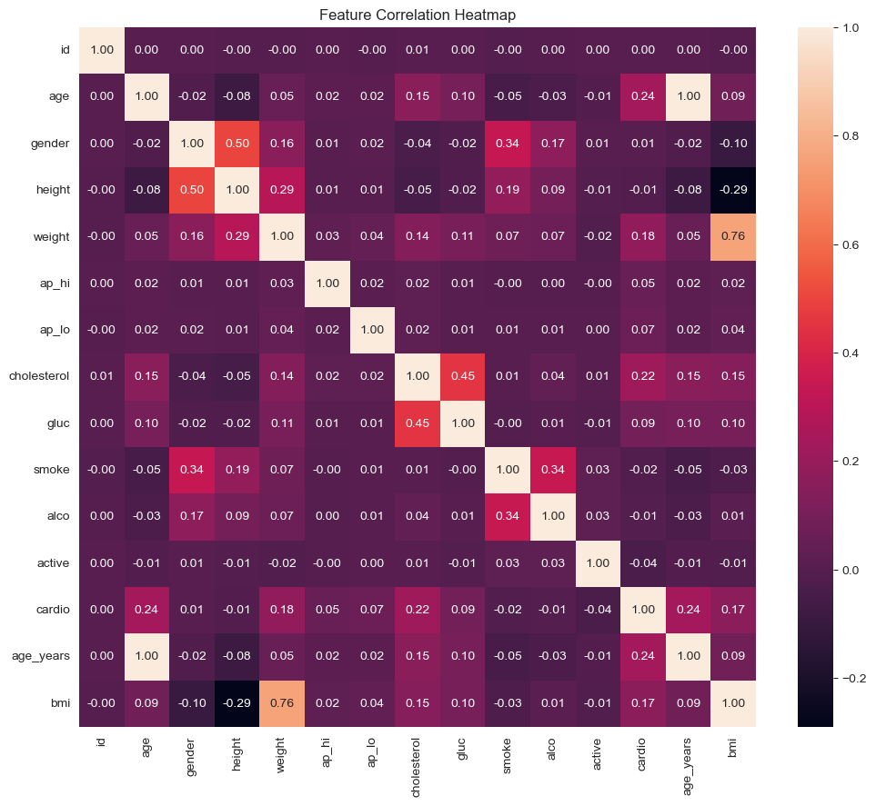
Exploring Relationships - Correlation Matrix
This type of plot visualizes the correlation coefficients between variables. Each square shows the correlation between the variables on each axis.
Correlation ranges from -1 to +1. Values closer to +1 indicate a strong positive correlation, values closer to -1 indicate a strong negative correlation, and values around 0 indicate no correlation.
Typically, darker colors represent stronger correlations (positive or negative).

Slide 9
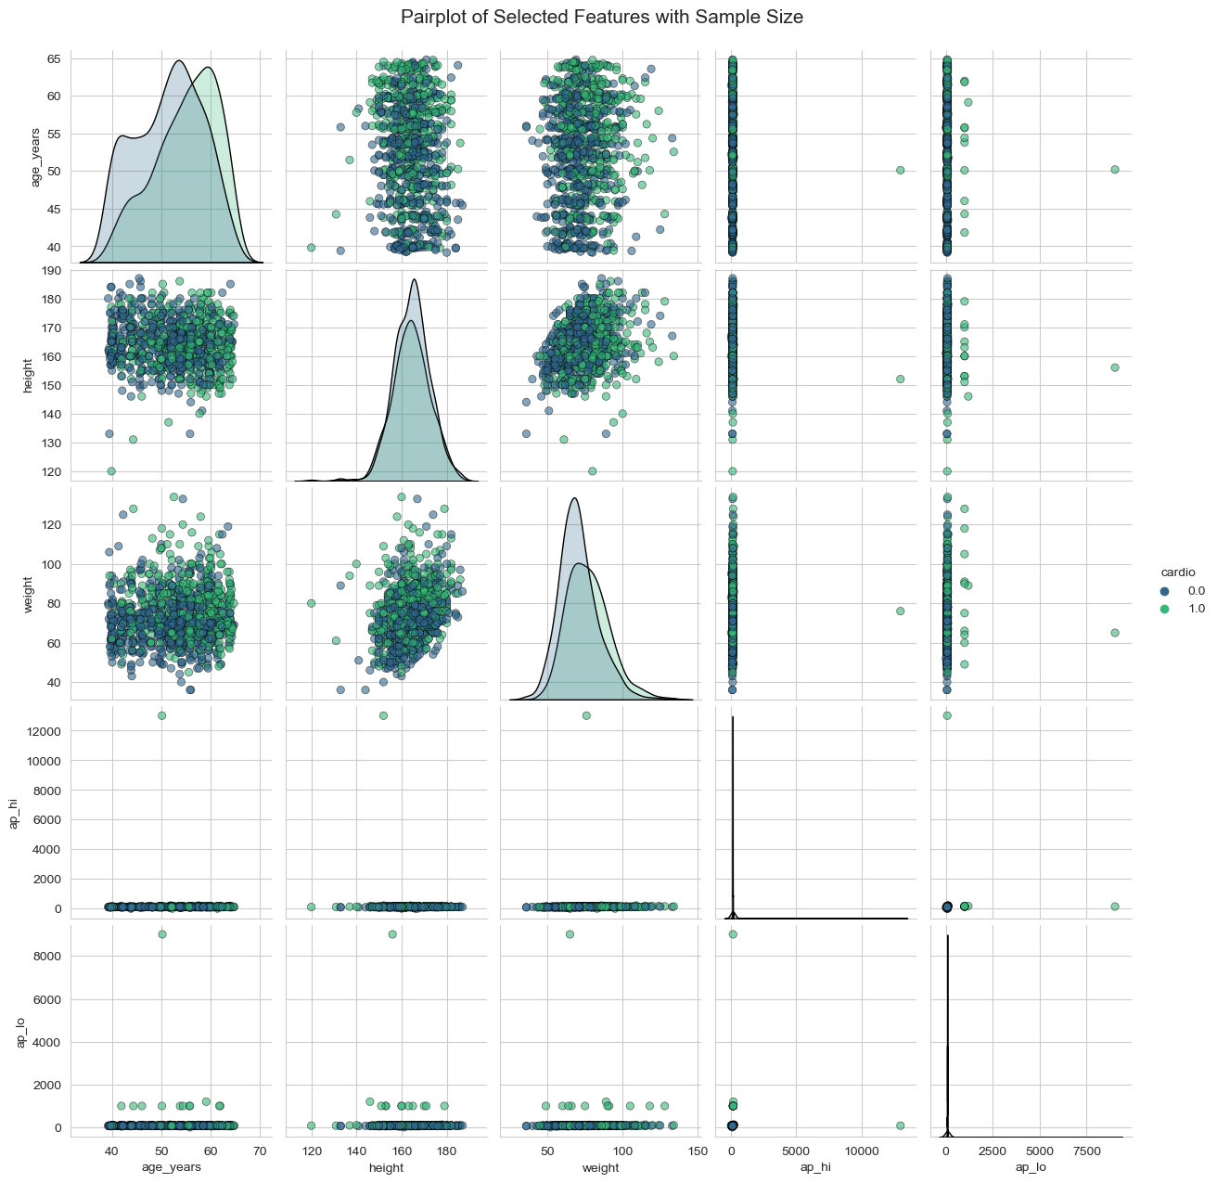
Multidimensional Feature Analysis
Pair plots show the bivariate relationships between each pair of features.
From the pair plot, you can see the distribution of single variables on the diagonal and relationships between two variables in the off-diagonal.
It can also be colored by a categorical variable to show the relationship with the category.
The plots on the diagonal represent the distribution of the dataset for the variable in question. Here it’s typically represented as a histogram or a kernel density estimate.

Slide 10
Data Preparation and Transformation 1
Imputation Strategy:
Even with minimal missing values, imputation ensures dataset integrity.
Mean imputation was chosen for its simplicity and effectiveness in maintaining the distribution of variables.
Outlier Treatment:
A significant number of rows (14,300) identified as outliers were removed.
This step minimizes skewness and improves model performance.
Feature Scaling:
Standard Scaler applied to numerical columns to normalize data.
Essential for models sensitive to the magnitude of data like SVM or k-nearest neighbors.
Categorical Encoding:
Most frequent imputation applied to categorical variables to fill missing data.
One-hot encoding transformed categorical variables into a machine-readable format, increasing model interpretability.
Age Conversion and Column Removal:
Age converted from days to years for better understanding and analysis.
Dropped the 'id' column and original 'age' column (in days) to focus on more relevant predictors.

Slide 11
Data Preparation and Transformation 2
Robust Imputation Technique: Applied median imputation to handle missing values, enhancing the dataset’s resilience against outliers and skewed distributions, thus strengthening the foundation for accurate model training.
Class Balance Optimization: Implemented Synthetic Minority Over-sampling Technique (SMOTE) to balance the class distribution, ensuring unbiased model learning and improving predictive performance for minority classes.

Slide 12
Types of Models
MODELING
Baseline
Model
Feature Engineered Model
Hyperparameter Tuned Model

Slide 13

Selecting the Best Tools for Prediction 1
Logistic Regression:
Ideal for binary classification problems.
Provides a probability score for observations.
Simplicity and interpretability for stakeholders.
It's a foundational algorithm for binary classification problems, like the presence or absence of heart disease, which makes it an appropriate initial model to assess linear relationships.
Decision Tree:
Captures non-linear patterns.
Can be visualized for easy interpretation.
Handles both numerical and categorical data.
Offers a clear visualization of decision paths, which can be useful for understanding key factors that contribute to heart disease.
K-Nearest Neighbors (KNN):
A non-parametric method that makes no assumptions about data distribution.
Versatile, used for classification and regression.
It's a non-parametric method that can capture complex patterns by considering the similarity of cases, which can be pivotal in diagnosing heart disease where the interplay of various health indicators matters.

Slide 14
Selecting the Best Tools for Prediction 2
Random Forest:
An ensemble of decision trees, improving prediction accuracy.
Reduces the risk of overfitting.
Can handle a large dataset with higher dimensionality.
An ensemble approach that can handle a large number of input variables without variable deletion, thus utilizing the full breadth of data collected in heart disease datasets.
XGBoost:
Known for its performance and speed.
Handles missing data and provides feature importance scores.
Regularization to prevent overfitting.
Known for its performance and speed, this algorithm can handle the non-linear relationships typical in medical data and has shown success in numerous Kaggle competitions dealing with health data.
LightGBM:
Optimized gradient boosting framework.
Faster training and higher efficiency.
Effective handling of large datasets and high-dimensional features.
A gradient boosting framework that is efficient with large datasets and many features, as often seen in heart disease datasets. It’s faster training and better accuracy make it suitable for our prediction needs.

Slide 15
Baseline Model Performance Metrics
Model | Accuracy | Precision | ROC-AUC
Logistic Regression | 0.723 | 0.745 | 0.786
Decision Tree | 0.632 | 0.633 | 0.632
KNN | 0.648 | 0.654 | 0.691
Random Forest | 0.712 | 0.716 | 0.771
XGBoost | 0.736 | 0.757 | 0.796
LightGBM | 0.740 | 0.761 | 0.802

Slide 16
Baseline Model Insights
Logistic Regression: Demonstrated balanced performance, serving as a solid baseline for binary classification with its ability to offer probabilities for heart disease prediction, thus being useful for initial screenings.
Decision Tree: Exhibited lower performance, which may indicate a tendency to overfit or struggle with the complexity of heart disease data, suggesting a need for refined tuning to better capture predictive patterns.
KNN (K-Nearest Neighbors): Showed moderate accuracy, implying that considering the closest neighbors provides some insight into the patterns of heart disease, although the model may benefit from incorporating more contextual data or fine-tuning the number of neighbors to consider.
Random Forest: As an ensemble of decision trees, it achieved better metrics, showcasing its strength in reducing overfitting and effectively capturing the multifaceted nature of heart disease data.
XGBoost: Scored high in ROC-AUC, demonstrating its capacity to handle the dataset's intricacies efficiently, indicative of its advanced feature handling and regularization capabilities, making it a robust candidate for further optimization.
LightGBM: Topped the performance charts, particularly in ROC-AUC, reflecting its superior handling of the dataset’s features and its efficient training methodology, signifying its readiness for scalable deployment in clinical environments where large datasets are the norm.

Slide 17
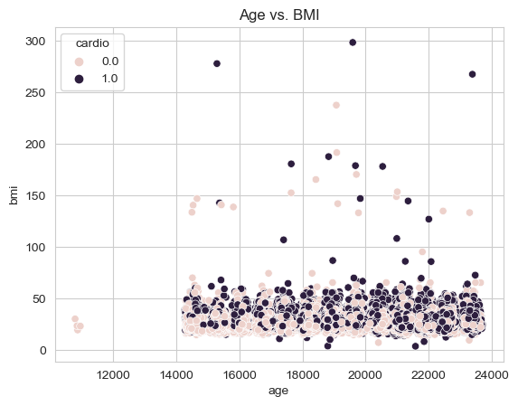
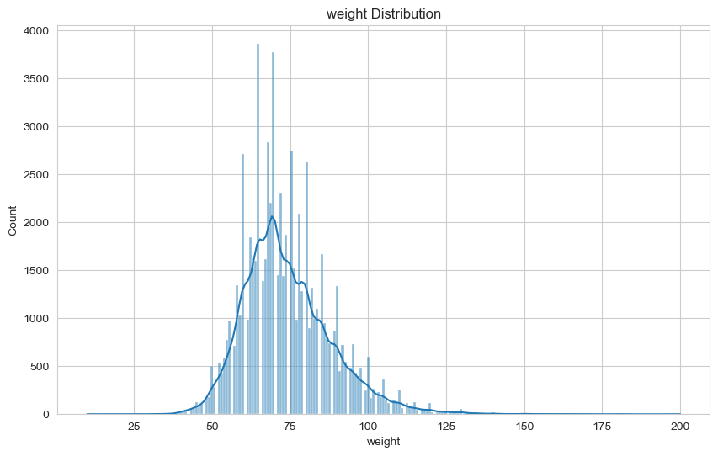
Visual Analysis

Slide 18

Crafting Insights: Advanced Feature Engineering for Heart Disease Prediction
Features Created:
BMI Calculation: Body Mass Index (BMI) was computed from height and weight, providing a single metric that encapsulates the overall body health related to weight status.
Blood Pressure Categorization: Blood pressure readings were categorized into normal, elevated, high, and hypertensive crisis, allowing for simplified analysis and better understanding of risk factors associated with each category.
Cholesterol and Glucose Levels: Cholesterol and glucose levels were also categorized, aiding in the identification of patients with higher risks for cardiovascular diseases.
Derived Combined Health Score: A combined health score was created from activity levels, smoking, and alcohol consumption data to represent a lifestyle health indicator.
Aim:
Enriched the dataset with nuanced features for deeper pattern recognition associated with heart disease risk.
Aimed to enhance model interpretability and prediction accuracy.
Provided comprehensive insights into critical heart health influencers.
Newly engineered features expected to boost the models' predictive capabilities.
Targeted at accurately identifying individuals at higher risk of cardiovascular disease.

Slide 19
Feature Engineering Model Metrics
Model | Accuracy | Precision | ROC-AUC
Logistic Regression | 0.732 | 0.762 | 0.785
Random Forest | 0.708 | 0.711 | 0.768
XGBoost Performance | 0.738 | 0.755 | 0.804
LightGBM Performance | 0.740 | 0.759 | 0.802

Slide 20
Impact of Feature Engineering on Model Performance
Logistic Regression
Slight increase in Precision suggests better positive class separation.
Stable Accuracy and ROC-AUC indicate unchanged overall predictive performance.
Random Forest
Decrease in all metrics could imply new features introduced noise or overfitting.
XGBoost
Improvement in ROC-AUC reflects better class differentiation capability.
Minor decrease in Accuracy might be due to sensitivity to new features.
LightGBM
Almost consistent performance with a minor change in Accuracy and Precision.
Stable ROC-AUC suggests the original features were already yielding near-optimal performance.
General Impact:
Mixed effects observed with feature engineering across different models.
Some models showed improved class differentiation but not overall accuracy.
Possible introduction of complexity without a significant prediction rate increase.
Feature engineering may benefit models differently based on their inherent characteristics and the nature of the dataset.

Slide 21
Understanding the Limits of Feature Engineering
Feature engineering can enhance machine learning models by generating or altering features to boost performance. Nonetheless, success is not guaranteed due to factors like:
Redundancy in Features:
Feature engineering can sometimes create new features that are highly correlated with existing ones, adding redundant information rather than contributing unique insights.
Risk of Overfitting:
Introducing more features can lead to overfitting, where the model learns noise from the training data, compromising its ability to generalize to new, unseen data.
Introduction of Noise:
Not all engineered features are helpful; some may introduce noise which can obscure the true patterns the model needs to learn, degrading performance.
Increased Complexity:
More features can unnecessarily complicate the model, especially if it was performing optimally with the initial set of features, potentially leading to diminishing returns.
Next Steps – Hyperparameter Tuning:
To potentially enhance model performance where feature engineering falls short, hyperparameter tuning is suggested as the next phase of model optimization.

Slide 22
The Role of Hyperparameter Tuning
Understanding Hyperparameter Tuning:
Hyperparameter tuning refers to the process of selecting a set of optimal hyperparameters for a learning algorithm.
A hyperparameter is a parameter whose value is set before the learning process begins.
Unlike model parameters, which are learned during training, hyperparameters are set in advance and guide the training process.
The Need for Hyperparameter Tuning:
The right hyperparameters can significantly improve model performance.
Each dataset is unique; hyperparameter tuning helps tailor the model to the specific characteristics of the dataset.
It's an essential step to avoid underfitting or overfitting, ensuring the model's generalizability to new, unseen data.

Slide 23
Hyperparameter Tuning: Finding the Right Configuration
Logistic Regression: Regularization strength (C) and penalty type were varied to control for overfitting and to determine the balance between simplicity and prediction power. A range of C values gives flexibility in how the model balances the trade-off between a perfect fit and a general solution.
Random Forest: The number of trees (n_estimators), maximum depth of trees (max_depth), minimum samples to split (min_samples_split), and minimum samples per leaf (min_samples_leaf) were adjusted to refine the model's complexity and to prevent overfitting.
XGBoost: Number of estimators (n_estimators), maximum depth (max_depth), and learning rate (learning_rate) were tuned to optimize the model's learning process and capacity to generalize.
LightGBM: Parameters such as number of estimators (n_estimators), learning rate (learning_rate), maximum depth (max_depth), number of leaves (num_leaves), subsample rate (subsample), and column sample by tree (colsample_bytree) were selected to control the model complexity and overfitting while speeding up training and increasing accuracy.

Slide 24
Hyperparameter Model Metrics
Model | Accuracy | Precision | ROC-AUC
Logistic Regression | 0.732 | 0.762 | 0.785
Random Forest | 0.737 | 0.766 | 0.802
XGBoost Performance | 0.738 | 0.755 | 0.803
LightGBM Performance | 0.740 | 0.760 | 0.804

Slide 25
Refined Predictive Power: The Impact of Hyperparameter Tuning
Logistic Regression's precision improved slightly, indicating a better identification of true positives.
Random Forest's ROC-AUC saw a significant increase, suggesting better overall model performance.
XGBoost's ROC-AUC improved marginally, which could mean better model reliability.
LightGBM's metrics remained relatively stable, indicating that the model was already performing optimally before tuning.
Post-tuning, ROC-AUC gains indicate enhanced class differentiation. Modest improvements suggest prior near-optimal parameters or models' performance ceiling with the current data.

Slide 26
Results Explanation - Performance Indicators Used
Accuracy: The proportion of true results among the total number of cases examined.
Precision: The proportion of true positive identifications over all positive identifications.
ROC-AUC: The area under the receiver operating characteristic curve; a plot of true positive rate against false positive rate.

Slide 27
Optimized Prediction with LightGBM
Chosen Model: LightGBM due to its leading performance in various metrics, indicating its high suitability for the task.
High Efficiency and Speed: LightGBM is designed for efficiency with large datasets, which is common in healthcare contexts.
Gradient Boosting Framework: Utilizes gradient boosting, which is effective at handling a large variety of features, beneficial for datasets with complex relationships like those found in health data.
Improved Handling of Categorical Features: Automates the handling of categorical features, which can be numerous and nuanced in health datasets.
Parallel Learning Supported: Expedites the training process, a valuable feature when working with extensive healthcare data.

Slide 28
Future Steps: Enhancing Model Predictivity
Data Augmentation: Explore techniques for increasing the size and variety of the dataset to improve the model's generalizability.
Feature Exploration: Further investigate additional or alternative feature engineering methods to uncover more significant predictors.
Deployment Strategy: Plan for a robust deployment strategy that includes model monitoring and updating to maintain performance over time.

Slide 29
Thank You
Group 3

